Slide 1
Automating Fabric Solution Deployment Guidance and Best Practices with CI/CD for Deploying and Updating Fabric Solutions

Slide 2
Agenda
Introduction to Fabric Solution Deployment
Challenges in Fabric Solution Deployment
Implementing Workflows to Deloy Fabric Solutions
Integrating Creation Parameters for Customer Data
Deploying and Updating Solutions from a Source Workspace
Implementing CI/CD using Staged Deployments
Managing Item Definitions using Fabric GIT Integration

Slide 3










Workspace with Sample Fabric Solution Scenarios
Fabric Power BI Solution
Fabric Lakehouse Solution with Notebook
Fabric Lakehouse Solution with Shortcut and Notebook
Fabric Lakehouse Solution with Data Pipeline and Notebooks
Semantic Model
Report
Lakehouse
Notebook
Semantic Model
Report
Lakehouse
Shortcut
Notebook
Semantic Model
Report
Lakehouse
Notebook
Data Pipeline
Semantic Model
Report

Slide 4
Workspace Item Types
Fabric solutions built using workspace items
Developers can discover, create and manage workspace items inside scope of a workspace
Some workspace item types require item definitions for creating and updating workspace items
Creatable Workspace Item Types by Workload
Data Engineering
Power BI
Data Warehouse
Data Factory
Real-time Intelligence
Data Science
Lakehouse
SemanticModel
Warehouse
DataPipeline
Eventhouse
MLExperiment
Notebook
Report
MirroredWarehouse
Dataflow
Eventstream
MLModel
SparkJobDefinition
KQLDatabase
Environment
KQLQueryset
KQLDashbord

Slide 5
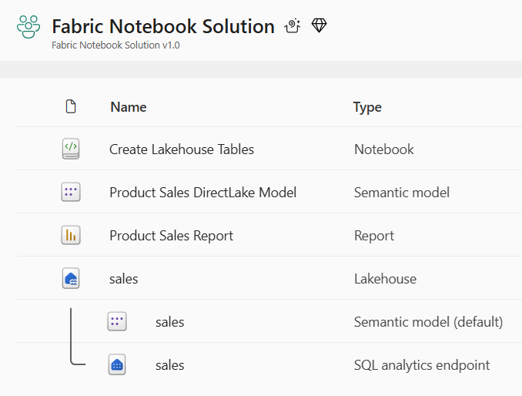
Deploying and Updating Solutions using Fabric REST APIs
ddddd
sssss
ddddd
sssss
Source Workspace
Target Workspace
Deploy
Items
Source Workspace
Target Workspace
Update
Items

Slide 6
First Motivation for Deployment using the Fabric REST API
Set up deployment stages to move between environments like DEV > TEST > PROD
Initial DEPLOY operation can create downflow workspaces on demand
DEPLOY workflow designed Entra tenant agnostic => It works across Entra Id tenant boundaries
DEPLOY workflow should be complimented with Update workflow
UPDATE workflow used to push out full or partial updates to workspace items.
Entra Id tenant A
Entra Id tenant B
Entra Id tenant C
Dev Workspace
Test Workspace
Deploy
Items
Prod Workspace
Deploy
Items
Dev Workspace
Test Workspace
Prod Workspace
Update
Items
Update
Items

Slide 7

Second Motivation for Deployment using the Fabric REST API
Fabric provides development platform for building multi-tenant applications
Each customer tenant created using one or more Fabric workspaces
Developer uses Fabric REST APIs to create and configure workspaces and workspace items
Fabric Multi-tenant Environment
Entra Id Tenant Owned by ISV
Customer 1 Tenant Workspace
Customer 01
17 users
Lakehouse
Notebook
Semantic Model
Report
Custom
Multitenant Application
Customer 2 Tenant Workspace
Lakehouse
Notebook
Semantic Model
Report
Customer 02
85 users
Customer N Tenant Workspace
Lakehouse
Notebook
Semantic Model
Report
Customer N
450 users

Slide 8
Designing a Solution Template for a Fabric Solution
Design workspace to serve as workspace template to provision customer tenants
Implement deployment workflow to create workspaces from Fabric solution template
Execute deployment workflow to create customer tenants
Deployment must support parameterization of unique customer data (e.g. datasource paths)
Customer 1
Workspace
Fabric Solution Template
Solution Deployment Logic
Implemented using Fabric REST APIs
Customer 2
Workspace
Customer 3
Workspace

Slide 9
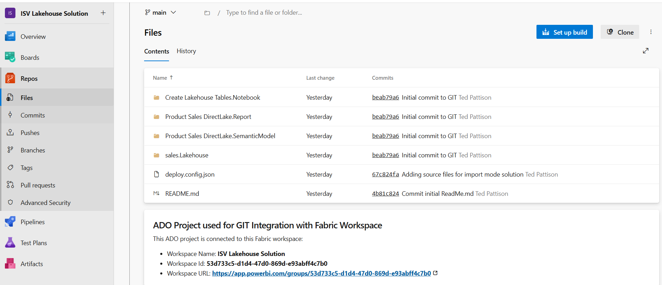
Fabric Support for GIT Integration

Slide 10
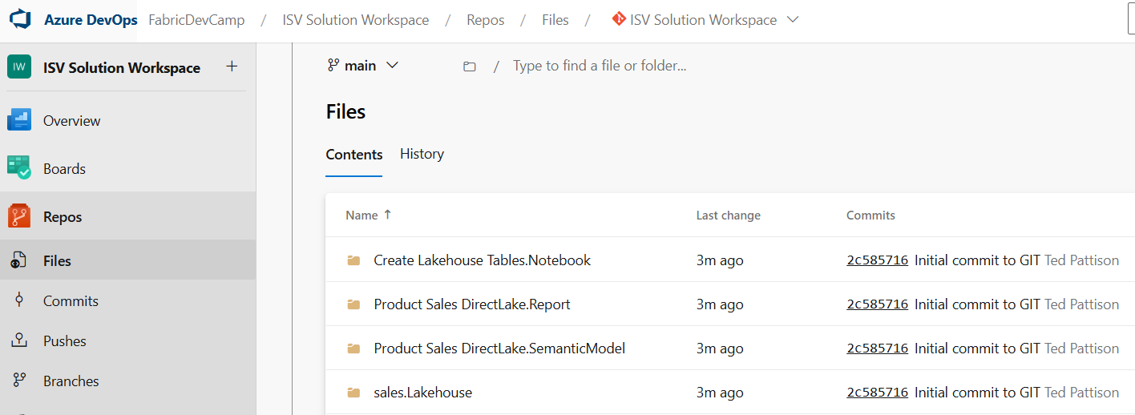
A First Glance at the Big Picture
What we work toward is this high-level architecture
Dev Workspace
Test Workspace
Deploy
or
Update
Prod Workspace
Deploy
or
Update
GIT
Sync

Slide 11
A First Glance at the Big Picture
What we work toward is this high-level architecture
Customer 1 Workspace
Deploy
or
Update
Dev Workspace
Test Workspace
Deploy
or
Update
Prod Workspace
Customer 2 Workspace
Deploy
or
Update
Deploy
or
Update
Deploy
or
Update
GIT
Sync
Customer N Workspace

Slide 12
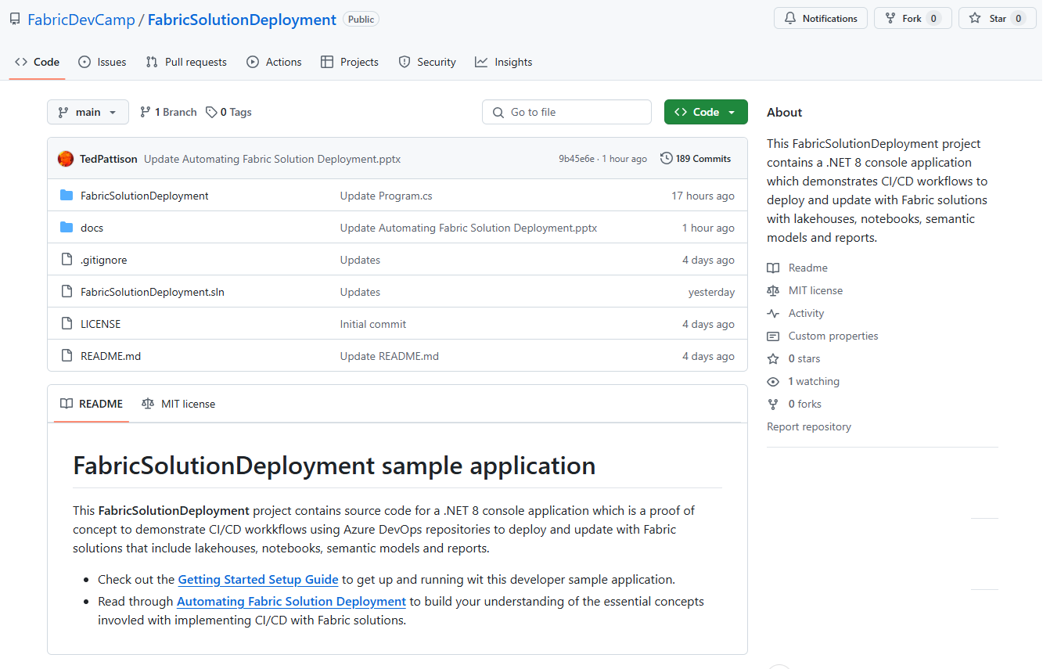
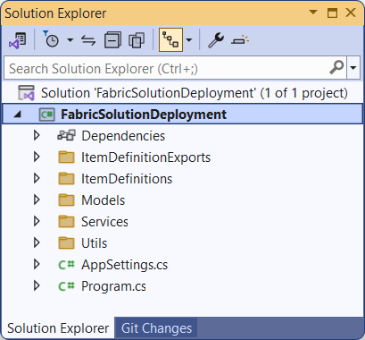
The FabricSolutionDeployment Developer Sample
Sample application demonstrating solution deployment workflows
Created as a .NET 8 console application using the Fabric REST API .NET SDK
Provides easy learning path for developers to download project and get up and running
https://github.com/FabricDevCamp/FabricSolutionDeployment

Slide 13
Sequence of Lab Exercises
Sequence of lab exercises when testing FabricSolutionDeployment project
Lab 01: Deploy Solution From Item Definitions
Lab 02: Export Item Definitions From Workspace
Lab 03: Parameterize Datasource Paths
Lab 04: Deploy Solution From Source Workspace
Lab 05: Update Solution From Source Workspace
Lab 06: Push Item Definitions To Azure DevOps Repo
Lab 07: Push Deploy Config File To Azure Dev Ops Repo
Lab 08: Deploy Solution From Azure DevOps Project
Lab 09: Update Solution From Azure DevOps Project
Lab 10: Export Solution Folder Package From Workspace
Lab 11: Deploy Solution From Solution Package Folder
Lab 12: Update Solution From Solution Package Folder

Slide 14
Agenda
Introduction to Fabric Solution Deployment
Challenges in Fabric Solution Deployment
Implementing Workflows to Deloy Fabric Solutions
Integrating Creation Parameters for Customer Data
Deploying and Updating Solutions from a Source Workspace
Implementing CI/CD using Staged Deployments
Managing Item Definitions using Fabric GIT Integration

Slide 15
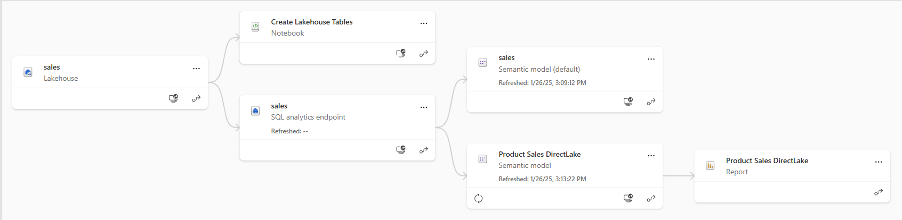
Understanding Workspace Item Dependencies
Many workspace items have dependencies on other workspace items
Notebook definition depends on workspace id and lakehouse id to reference its default lakehouse
DirectLake semantic model definition depends on connection string to SQL endpoint of lakehouse
Report definition depends on semantic model id
After deployment, solution should not have dependencies on other workspaces
All dependencies should be self-contained in new workspace
Fabric solution deployment requires custom logic to update dependencies accordingly

Slide 16
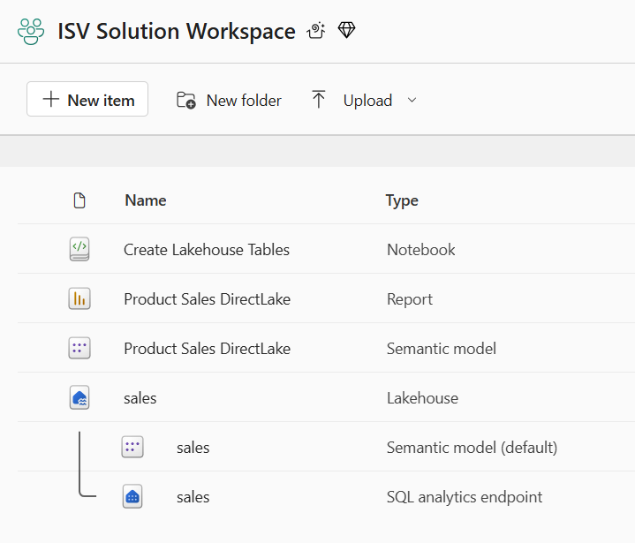
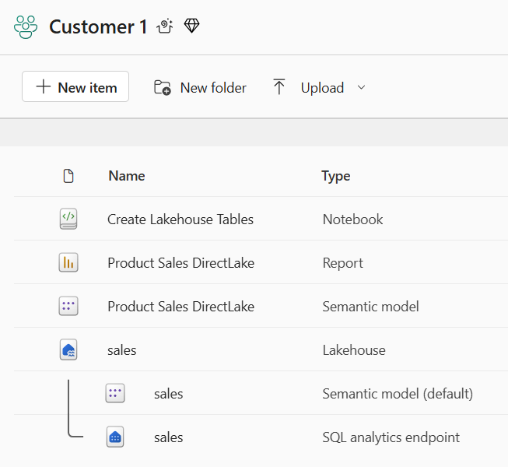
Creating Workspace Items with Dependencies
Deployment workflow must create workspace items with dependencies last
Notebook definition depends on lakehouse id for its default lakehouse
DirectLake semantic model definition depends on connection string to SQL endpoint of lakehouse
Report definition depends on semantic model id
Shallow copy of template workspace is not the result you want
Workspace for customer tenant should not have dependencies on soure workspace
Source Workspace
Target Workspace

Slide 17
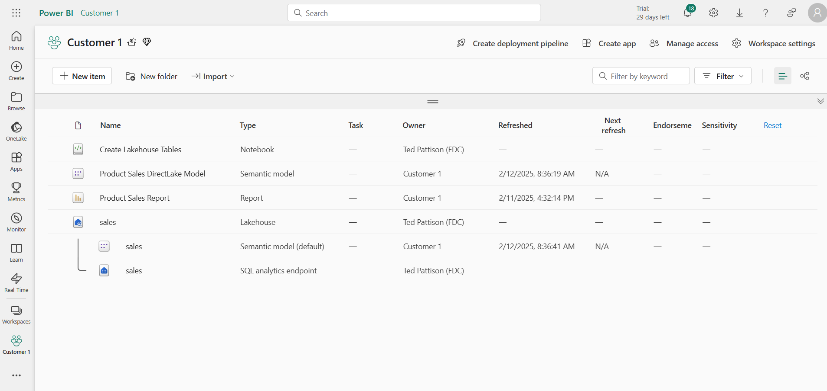
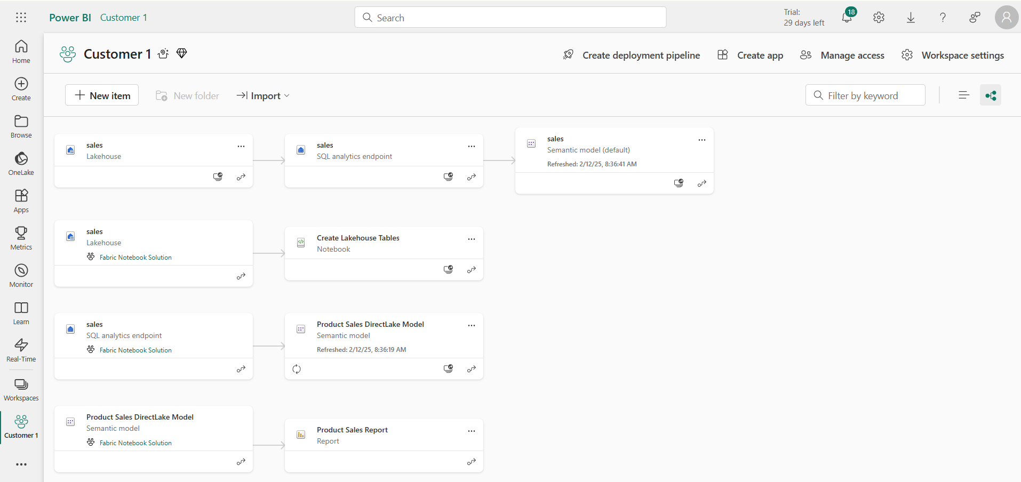
This deployment result IS NOT what you want
Checking for intra-workspace dependencies
Navigate to Lineage view to see item dependencies
Look for items that have dependencies on items in other workspaces

Slide 18
Challenge of Managing Connections at Workspace Scope
Unlike workspace items, connections are scoped at level of Entra Id tenant
No API support for workspace-level management of connections
Developer must find innovative approach for handling connections
Platform Item Types
Capacity
Workspace
Connection
Gateway
Workspace Item Types by Workload
Power BI
Data Engineering
Data Warehouse
Data Factory
Real-time Intelligence
Data Science
SemanticModel
Lakehouse
Warehouse
DataPipeline
Eventhouse
MLExperiment
Report
Notebook
MirroredWarehouse
Dataflow
Eventstream
MLModel
SparkJobDefinition
KQLDatabase
Environment
KQLQueryset
KQLDashbord

Slide 19
Parameterizing Customer Data and Datasource Paths
Solution design required to parameterize customer data
Deployment workflow must integrate creation parameters unique to each customer
This is especially true for datasource path
Customer 1 Datasources
Customer 1
Workspace
ADLS Gen2
Storage Container
Azure
SQL Database
Fabric Solution Template
Solution Deployment Logic
Customer 2 Datasources
Customer 2
Workspace
ADLS Gen2
Storage Container
Azure
SQL Database
Customer 3 Datasources
Customer 3
Workspace
ADLS Gen2
Storage Container
Azure
SQL Database

Slide 20
Agenda
Introduction to Fabric Solution Deployment
Challenges in Fabric Solution Deployment
Implementing Workflows to Deloy Fabric Solutions
Integrating Creation Parameters for Customer Data
Deploying and Updating Solutions from a Source Workspace
Implementing CI/CD using Staged Deployments
Managing Item Definitions using Fabric GIT Integration

Slide 21
Programming with Fabric Item Definitions
Fabric items can be created and updated using item definitions
You can pass item definition when calling Create Item API
You can modify existing workspace item by calling Update Item Definition passing item definition
You can retrieve item definition for existing workspace item by calling Get Item Definition
Your Application
Fabric REST APIs
Item
Definition
POST - Create Item
Item
Definition
POST - Update Item Definition
Item
Definition
POST - Get Item Definition

Slide 22
Deploying Solution by Copying Items in Source Workspace
Fabric items can be cloned using item definitions
Retrieve item definition from source workspace by calling Get Item Definition
Manipulate content of item definition parts
Pass manipulated item definition to Create Item API to create new item
Pass manipulated item definition to Update Item Definition API to update existing item
Source
Workspace
Your Application
Target
Workspace
Item
Definition
Item
Definition
Create Item
Get Item Definition
Item
Definition
Update Item Definition

Slide 23
Sequence of Deployment Steps in Power BI Solution
Create DirectLake semantic models
Create imported semantic model using updated item definition
Track semantic model id for later use
Create Web connection with same location as semantic model
Bind connection to semantic model
Refresh semantic model
Create Power BI reports
Create report using updated item definition that includes semantic model id

Slide 24
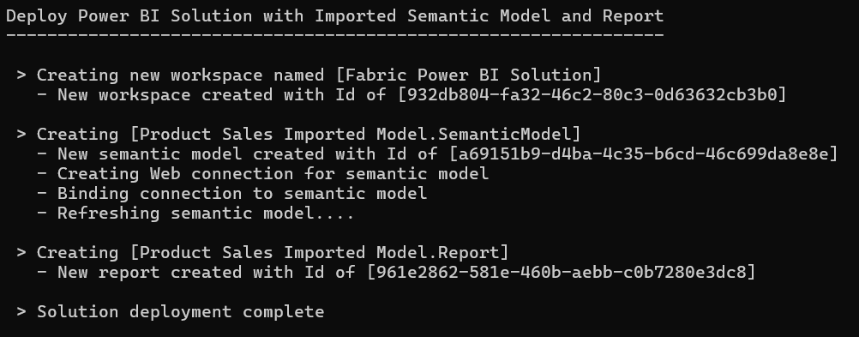


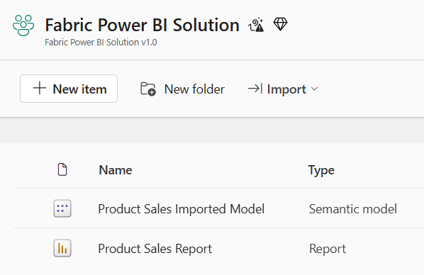
Deploy the Power BI Solution
Workspace (Power BI solution)
Semantic Model
Report

Slide 25
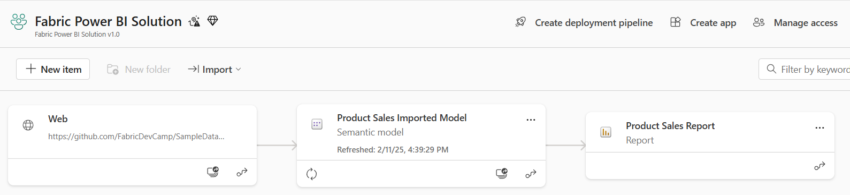
Power BI Solution Post Deployment
All dependencies are self-contained within the new workspace
There are no dependances on workspace items in other workspaces

Slide 26
Sequence of Deployment Steps in Notebook Solution
Create lakehouses
Lakehouse has no dependencies on other workspace items
After creation, track lakehouse id for later use
Query lakehouse properties to discover SQL endpoint server connect string and database Id
Create notebooks
Create notebook using item definition that includes workspace id & lakehouse id
Run notebook and monitor execution until completion to create lakehouse table schema
Create DirectLake semantic models
Create semantic model using updated item definition that includes SQL endpoint connect string
After creation, track semantic model id for later use
After creation, create & bind connection and then refresh semantic model (if required)
Create Power BI reports
Create report using updated item definition that includes semantic model id

Slide 27
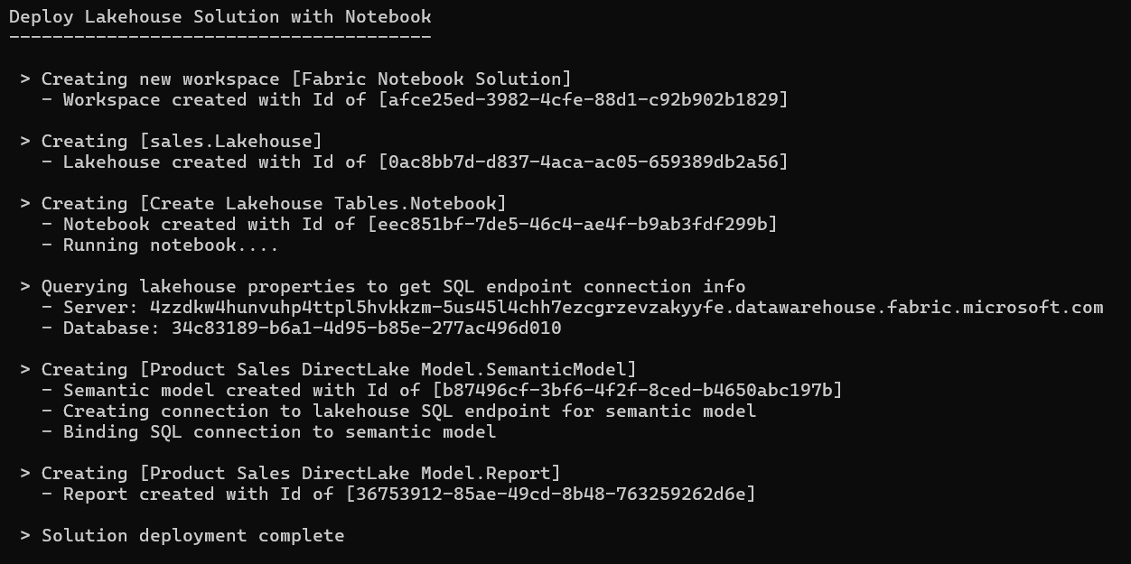




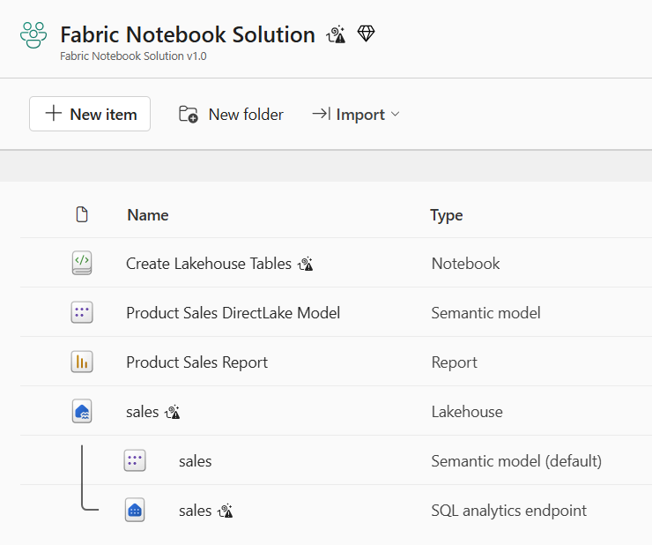
Deploy the Notebook Solution
Workspace (Notebook Solution)
Lakehouse
Notebook
Semantic Model
Report

Slide 28
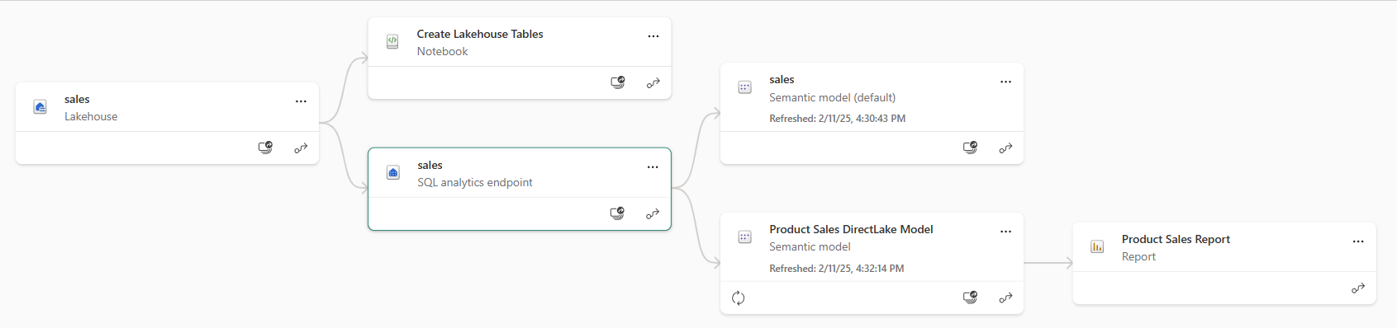
Notebook Solution Post Deployment
All dependencies are self-contained within the new workspace
There are no dependances on workspace items in other workspaces

Slide 29

Custom Application
Fabric Environment
Customer Workspace
OneLake Shortcut
Outbound Security
Connection to external Datasource
ADLS Gen2
Storage Container
Inbound Security
Calls to Fabric REST API
Semantic Model
Outbound Security
Connection to external Datasource
Azure
SQL Database

Slide 30
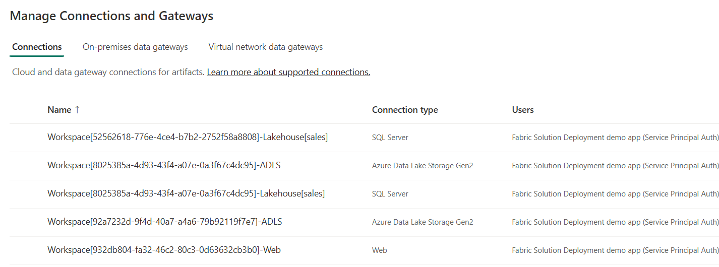
Using a Naing Convention for Managing Connections
ssddd
sswsww
zzz
Workspace[WORKSPACE_ID]-Lakehouse[sales]
Workspace[WORKSPACE_ID]-ADLS
Workspace[WORKSPACE_ID]-Web

Slide 31
Recreating Source Workspace Connections
ddd

Slide 32
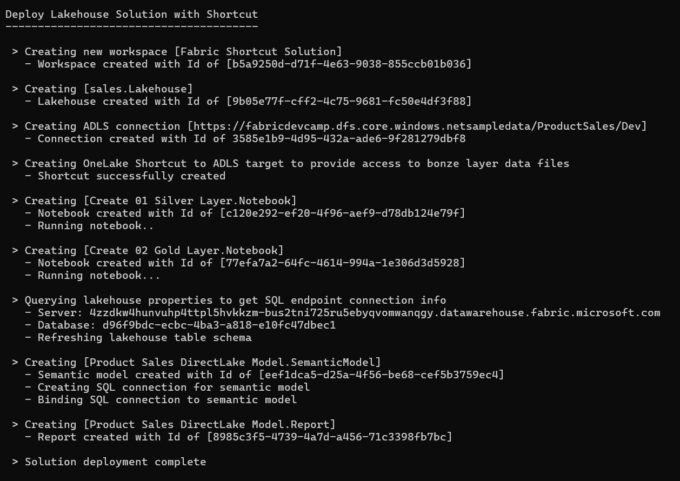





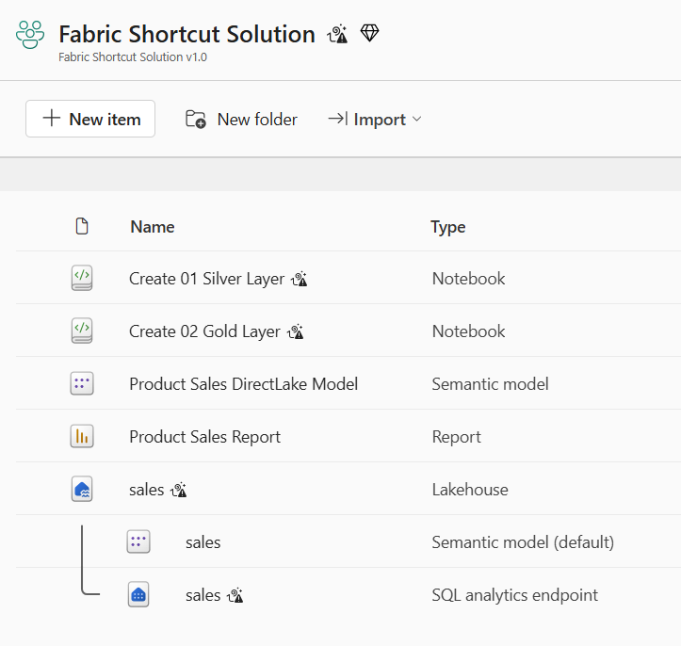
Deploy Shortcut Solution
Workspace (Shortcut Solution)
Lakehouse
Shortcut
Notebook
Semantic Model
Report

Slide 33
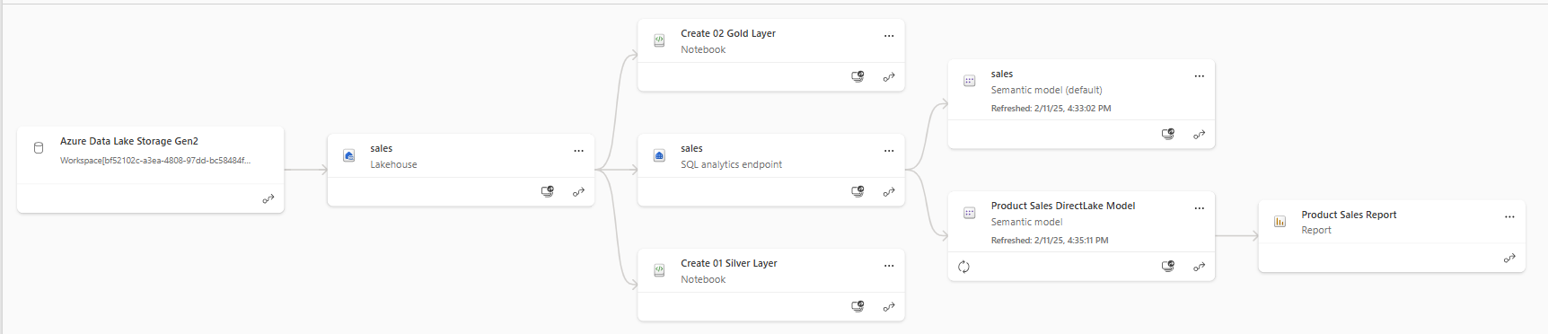
Shortcut Solution Post Deployment
All dependencies are self-contained within the new workspace
There are no dependances on workspace items in other workspaces

Slide 34
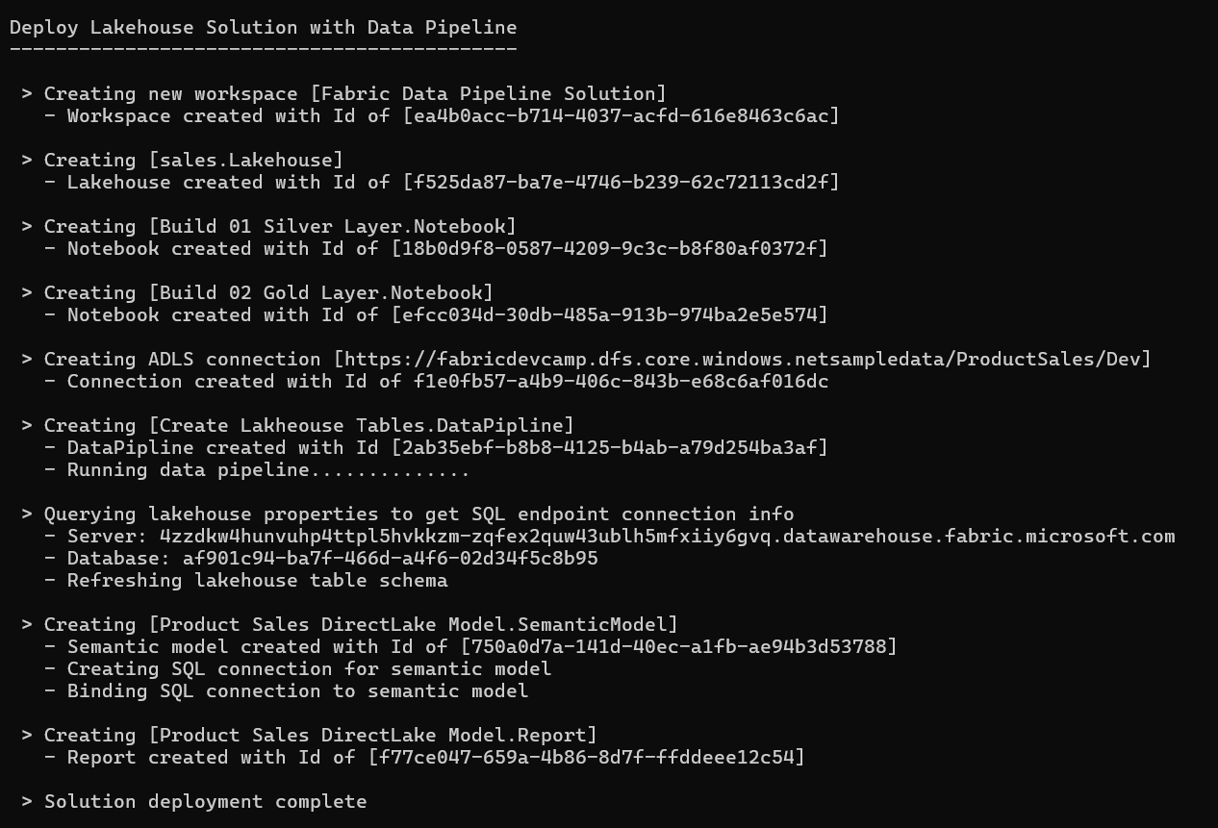





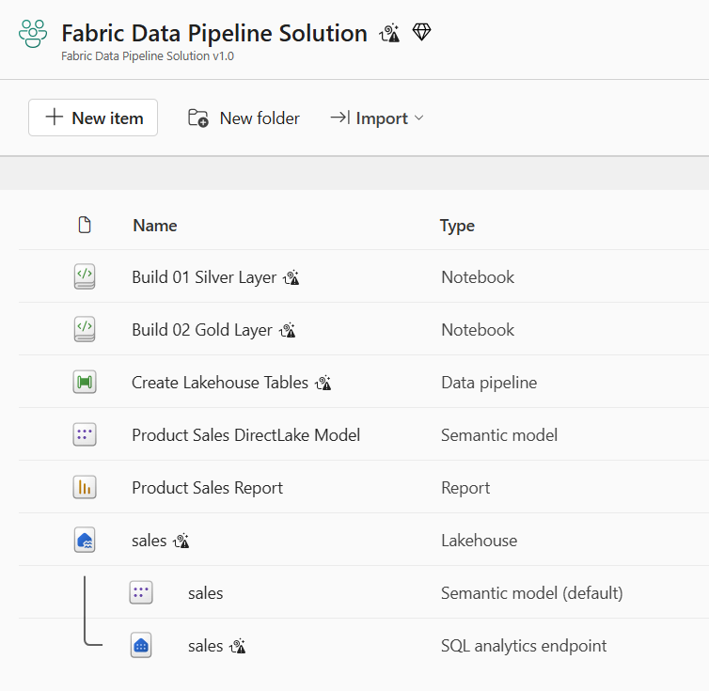
Deploy the Data Pipeline Solution
Workspace (Data Pipeline Solution)
Lakehouse
Notebook
Data Pipeline
Semantic Model
Report

Slide 35
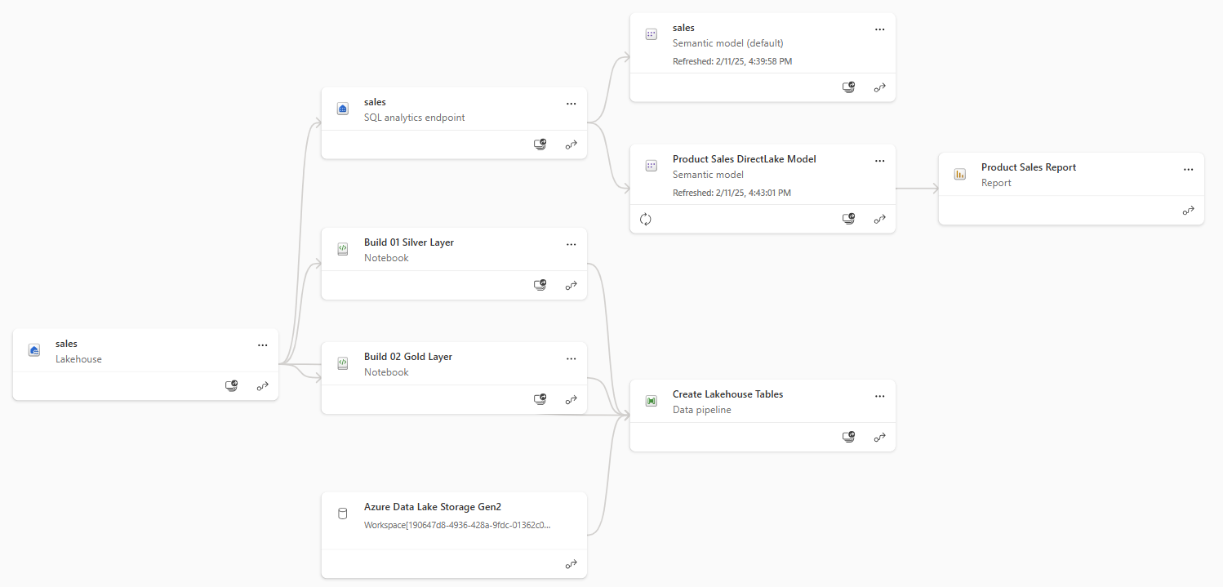
Data Pipeline Solution Post Deployment
All dependencies are self-contained within the new workspace
There are no dependances on workspace items in other workspaces

Slide 36
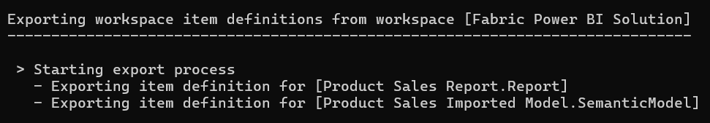
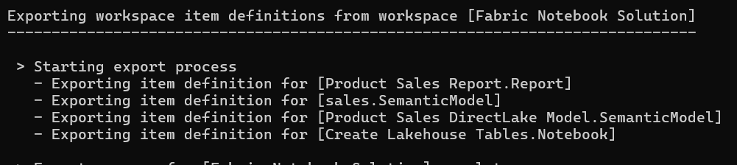
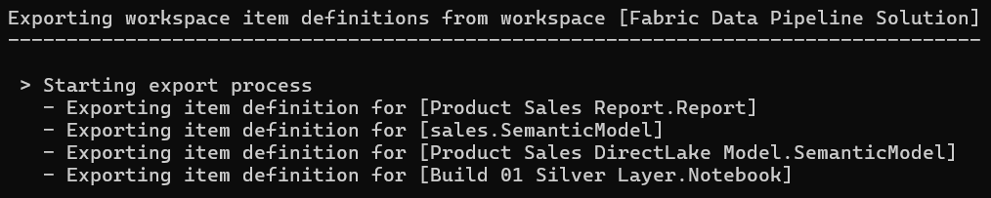
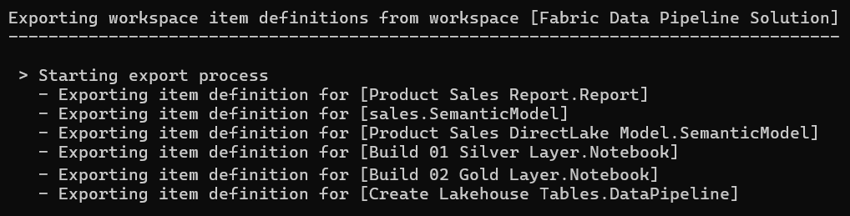
Exporting Workspace Definitions
ss

Slide 37
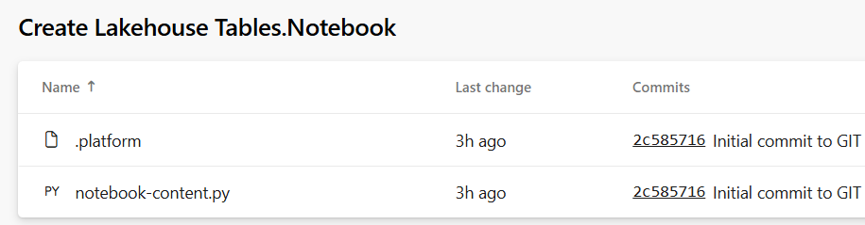
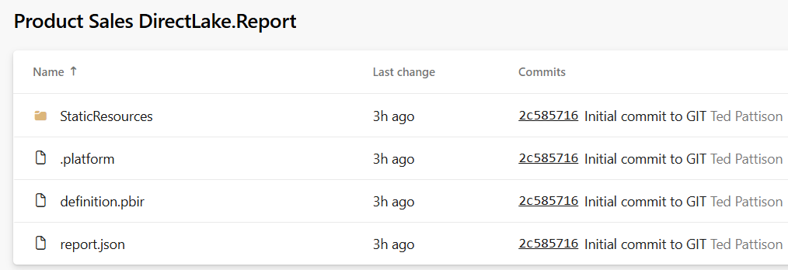
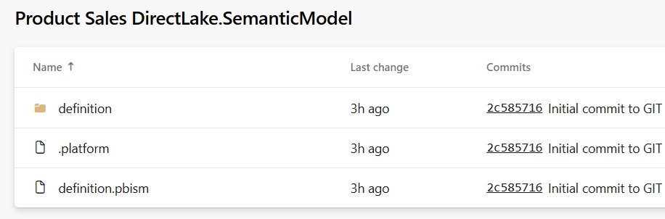
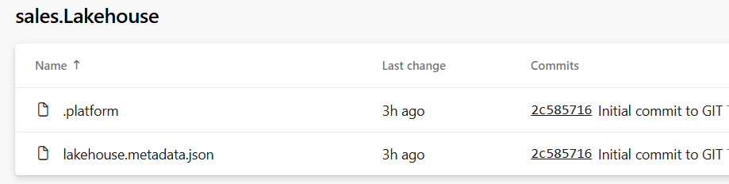
Item Definition Files
Fabric ALM strategy with CI/CD based on item definition files
Fabric automatically serializes workspace items into set of item definition files
Each type of workspace item defines the set of files that constitutes a valid item definition

Slide 38
Agenda
Introduction to Fabric Solution Deployment
Challenges in Fabric Solution Deployment
Implementing Workflows to Deloy Fabric Solutions
Integrating Creation Parameters for Customer Data
Deploying and Updating Solutions from a Source Workspace
Implementing CI/CD using Staged Deployments
Managing Item Definitions using Fabric GIT Integration

Slide 39
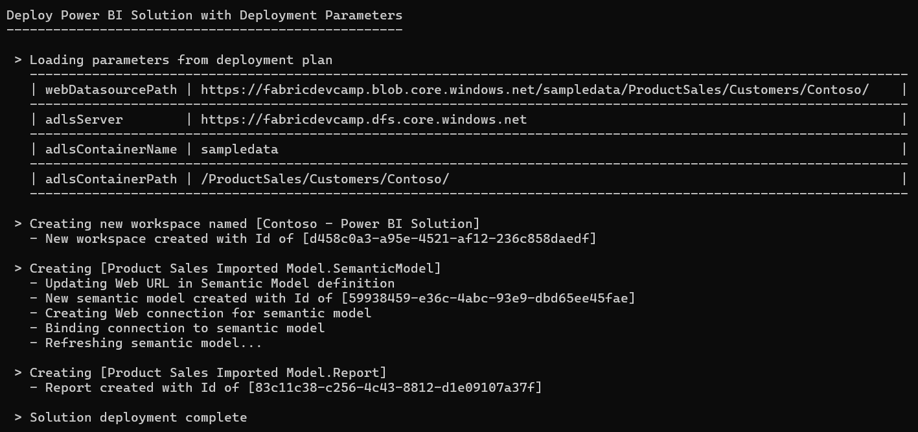

Slide 40
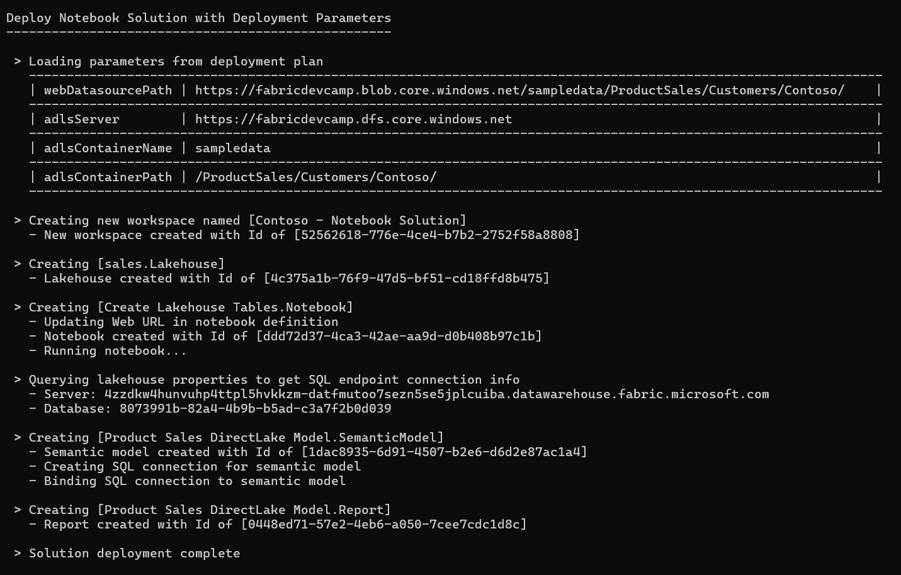

Slide 41
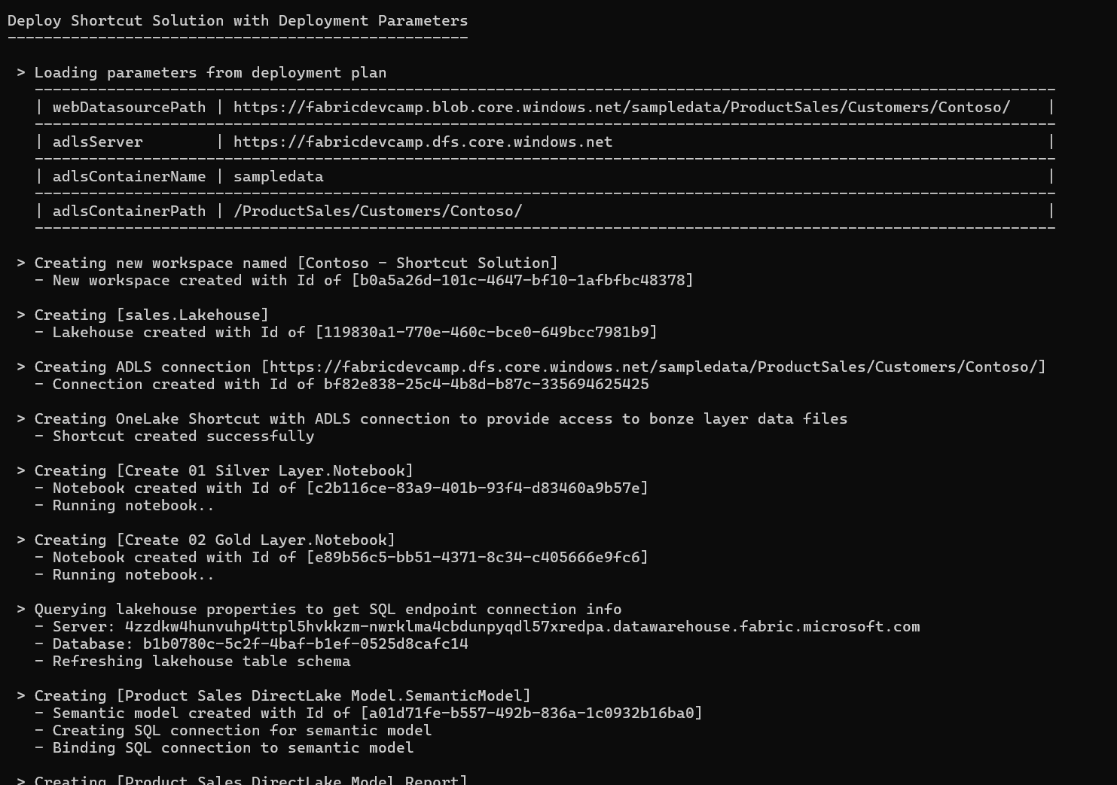

Slide 42
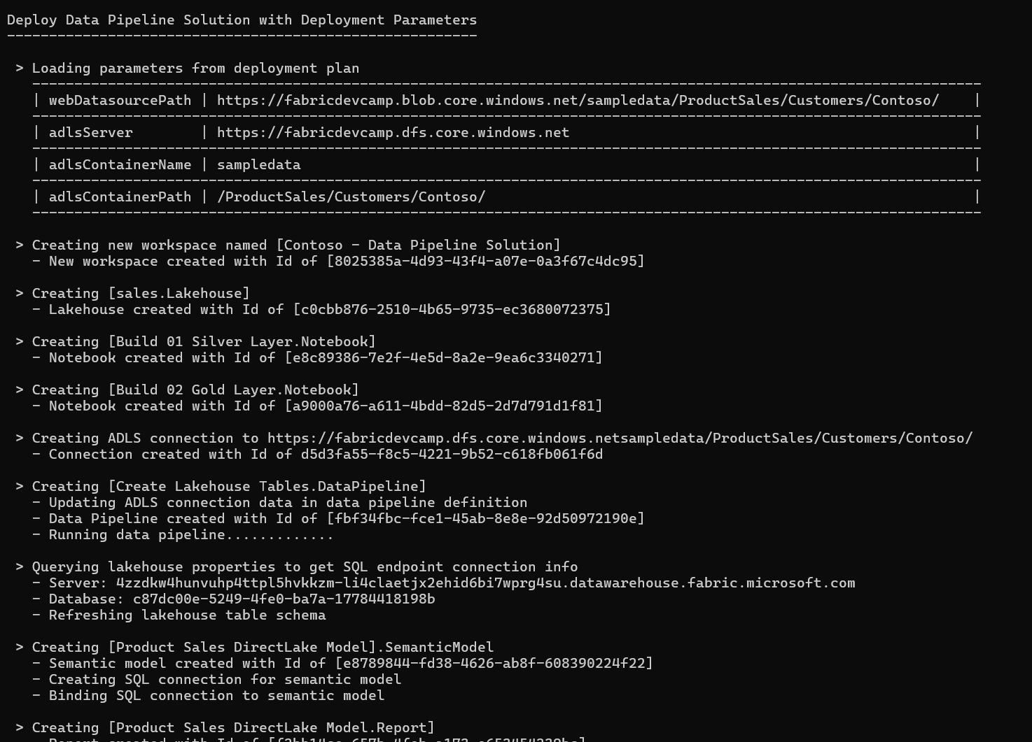

Slide 43
Where Do Datasource Paths Live in a Solution
Inside item definition files in semantic models
Example item definitions files with datasource paths include expressions.tmdl and model.bim
Inside Notebooks
Developers can add URLs directly in their python code
In connections
A connection is a credential bound to a datasource path
In shortcut
Shortcut created with datasource path
Shortcut must be bound to connection with same datasource path
In data pipeline
Data pipeline created to reference connection to external datasource
Connection created with target datasource path

Slide 44
Agenda
Introduction to Fabric Solution Deployment
Challenges in Fabric Solution Deployment
Implementing Workflows to Deloy Fabric Solutions
Integrating Creation Parameters for Customer Data
Deploying and Updating Solutions from a Source Workspace
Implementing CI/CD using Staged Deployments
Managing Item Definitions using Fabric GIT Integration

Slide 45
Deploy Solution from Source Workspace
Solution deployed from source workspace designed as solution template
Developer calls Get Item Definition on source workspace items
Developer modifies item definitions from source to redirect dependencies
Developer calls Create Item to create new item in solution workspace
Deploy Solution Logic

Slide 46
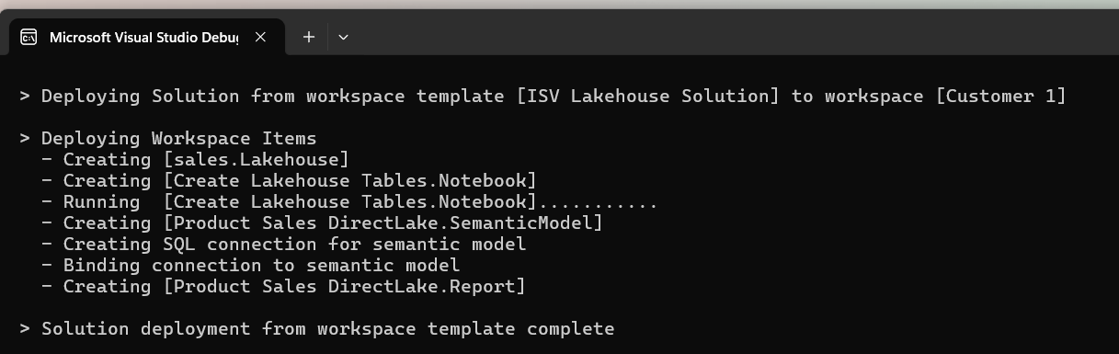
Deploy Solution Logic
Implemented Using Fabric REST APIs

Slide 47
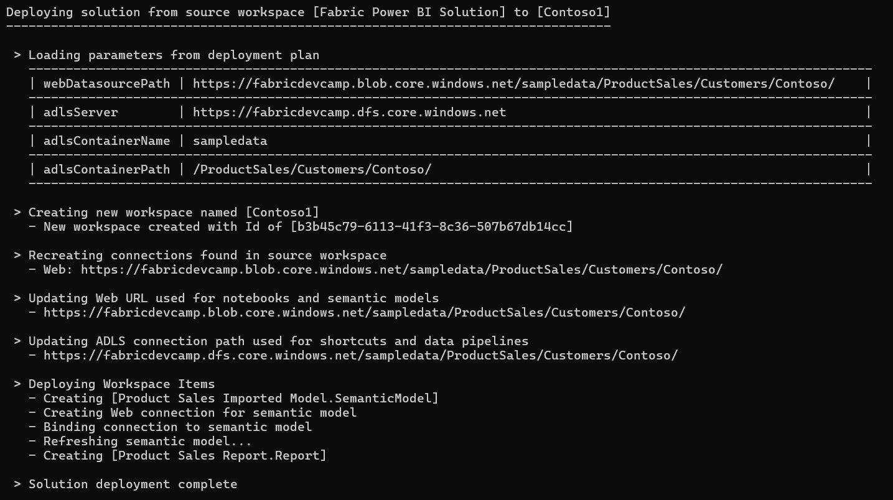

Slide 48
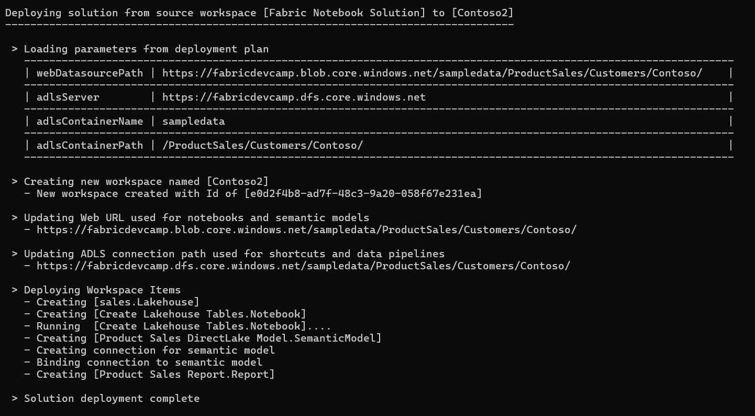

Slide 49
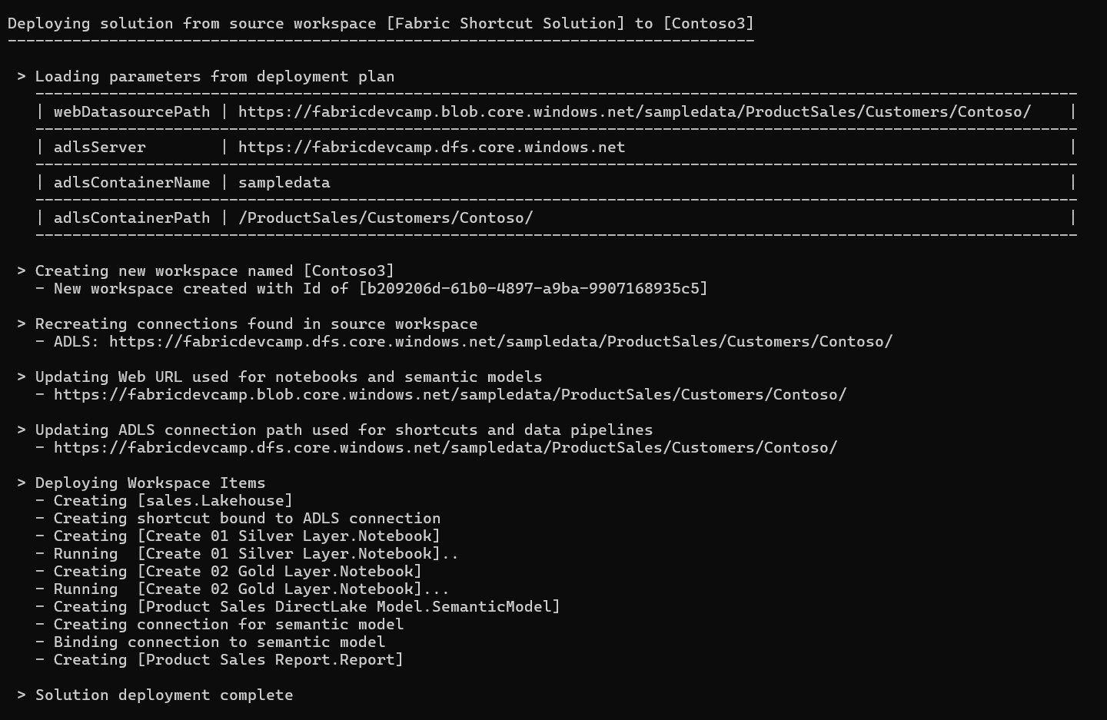

Slide 50
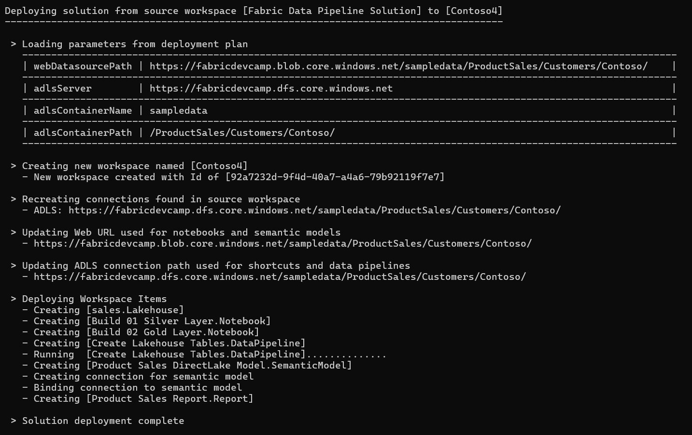

Slide 51
Update Solution from Source Workspace
Developer needs a way to update existing items with change in template workspace
Using delete and create operation is not good because it changes workspace item Id
Developer calls Update Item Definition to update solution items from template items
Update logic can create new workspace items recently added to workspace template
Update logic can delete orphaned items that do not exist in workspace template
Update Solution Logic
Implemented Using Fabric REST APIs

Slide 52
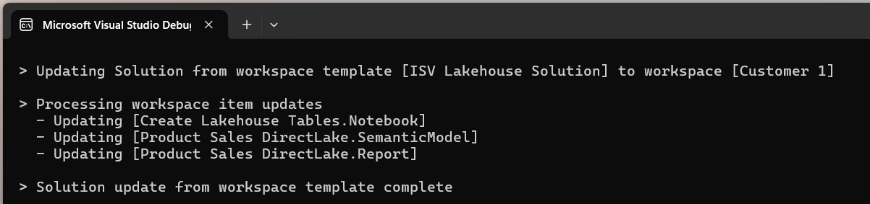
Update Solution Logic
Implemented Using Fabric REST APIs

Slide 53
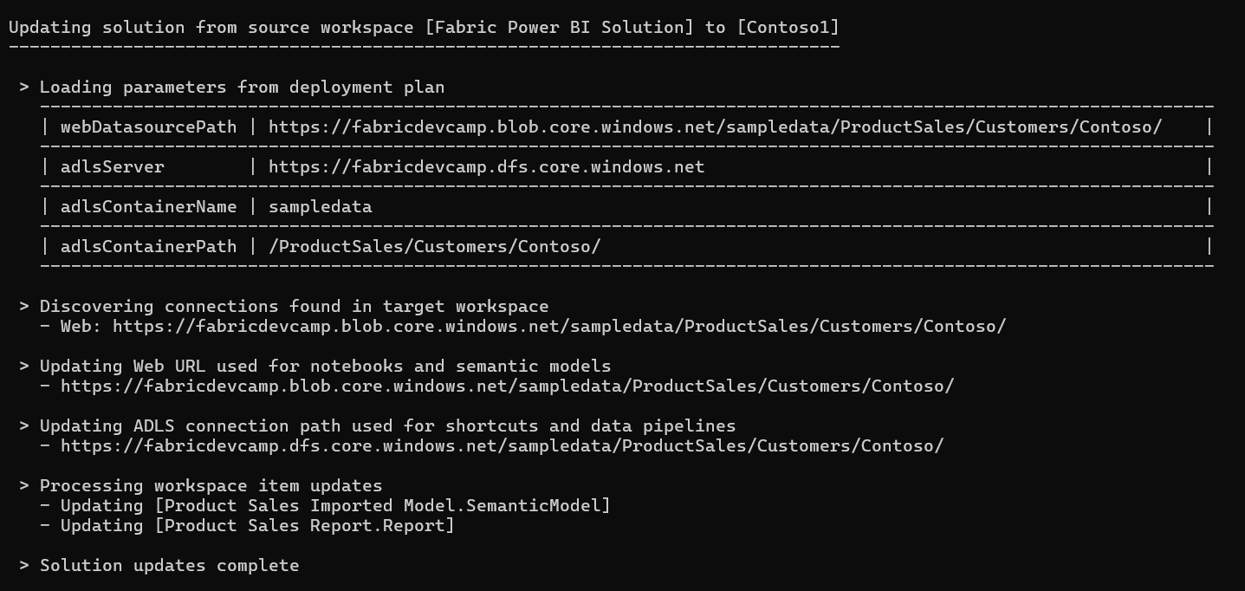

Slide 54
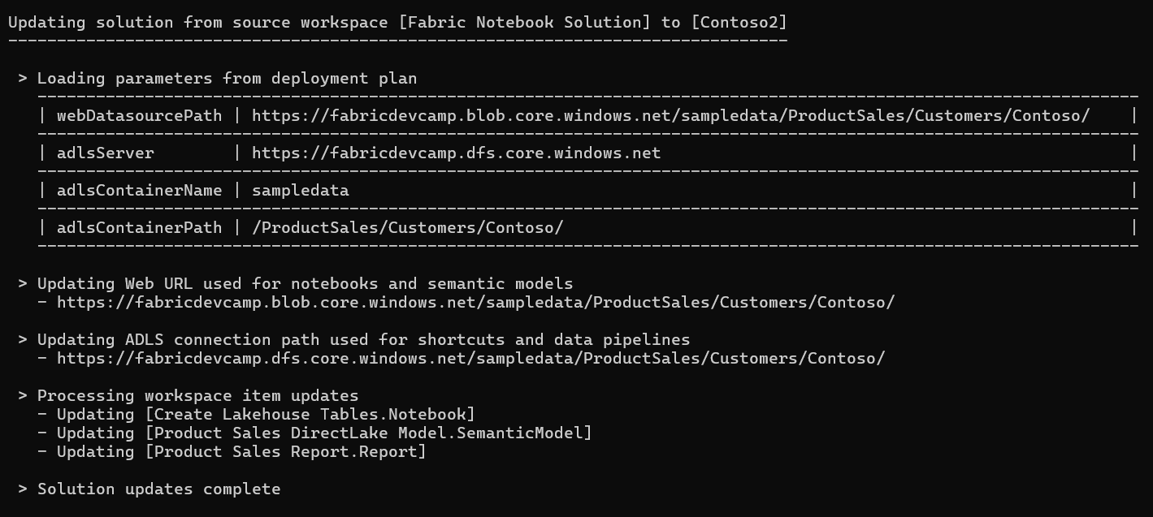

Slide 55
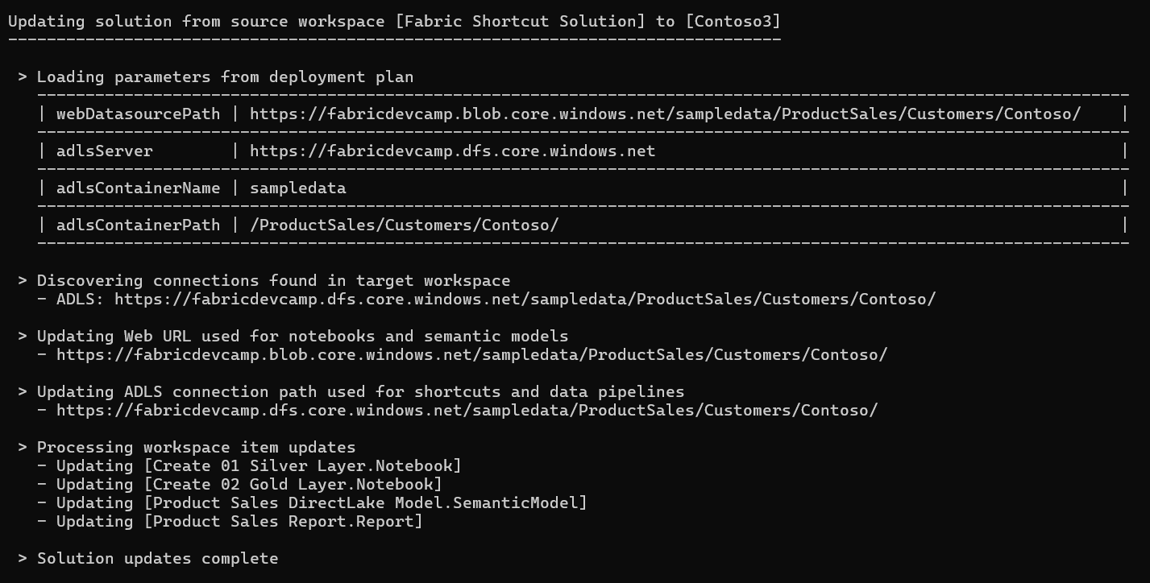

Slide 56
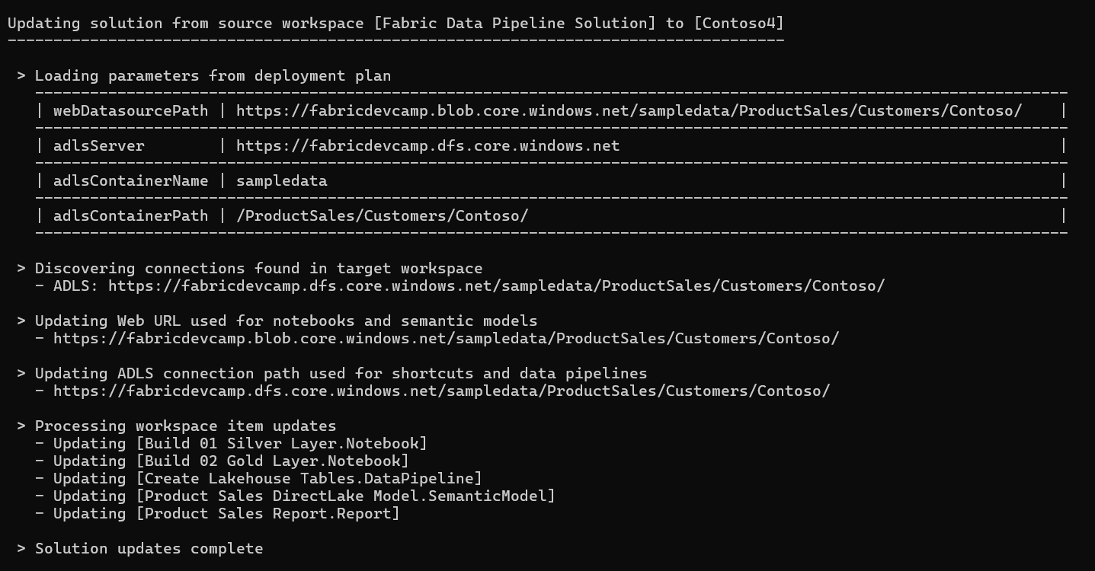

Slide 57
Agenda
Introduction to Fabric Solution Deployment
Challenges in Fabric Solution Deployment
Implementing Workflows to Deloy Fabric Solutions
Integrating Creation Parameters for Customer Data
Deploying and Updating Solutions from a Source Workspace
Implementing CI/CD using Staged Deployments
Managing Item Definitions using Fabric GIT Integration

Slide 58
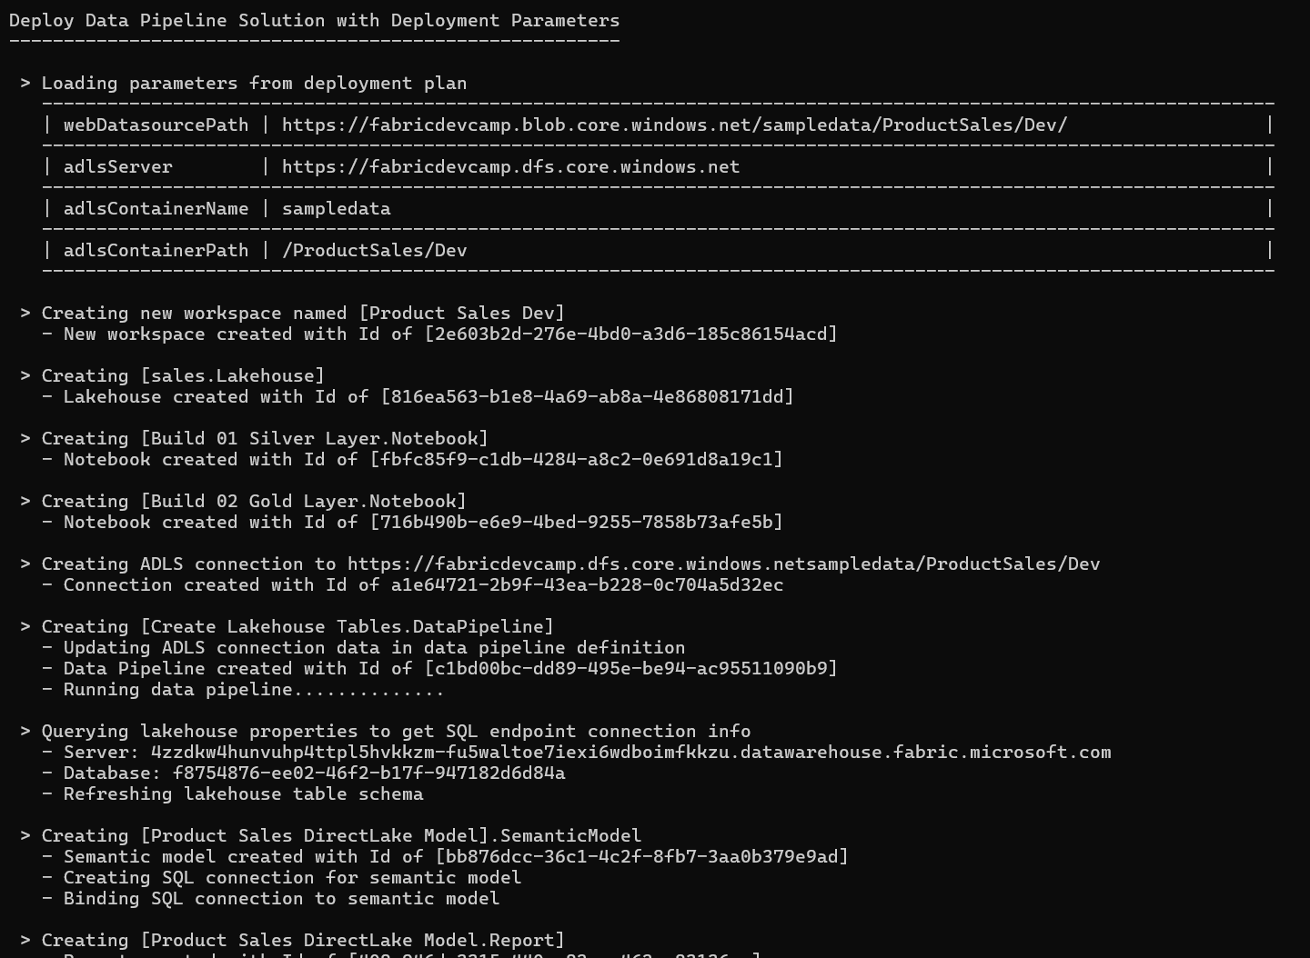

Slide 59
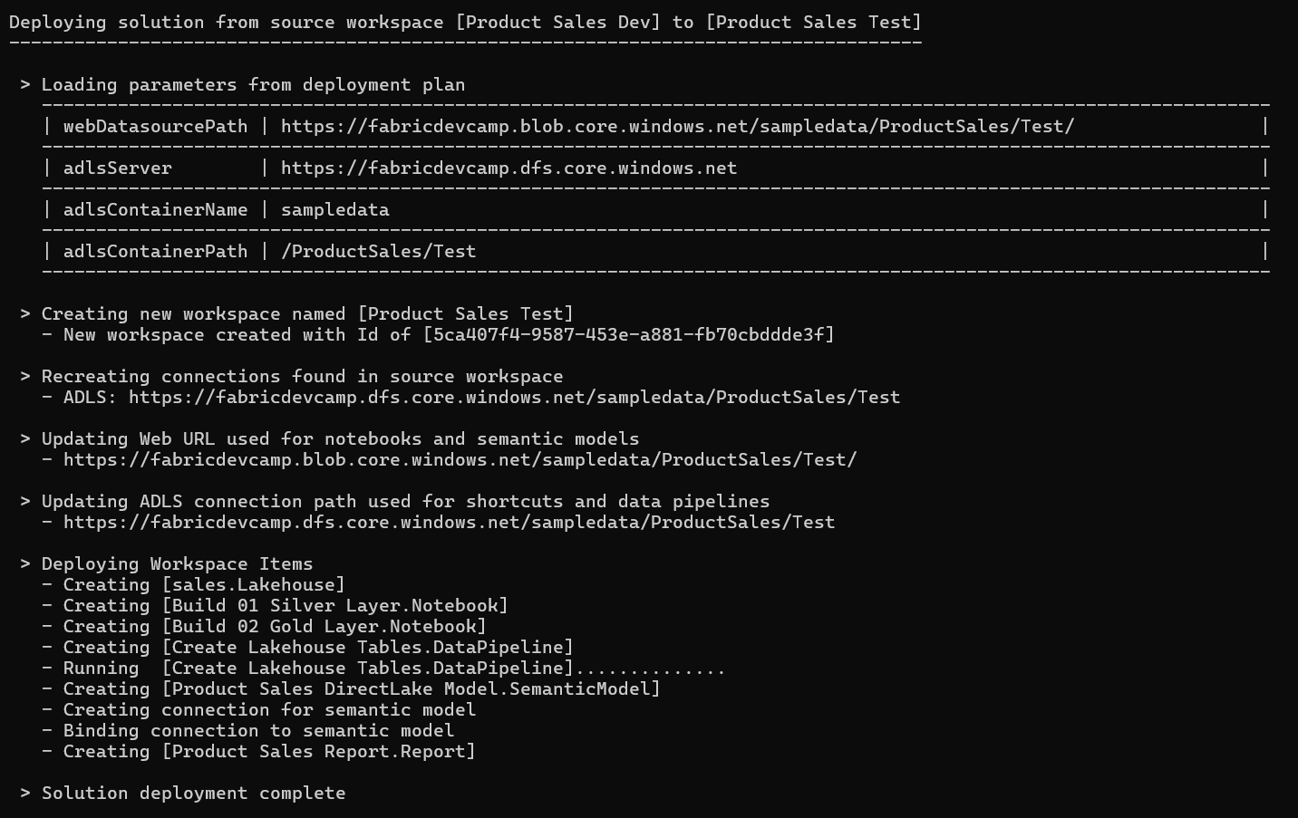

Slide 60
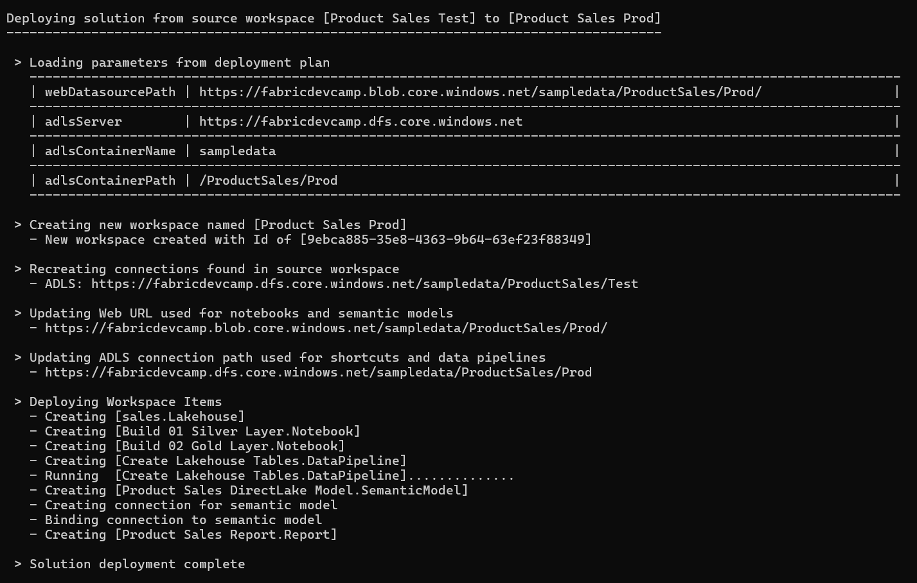

Slide 61
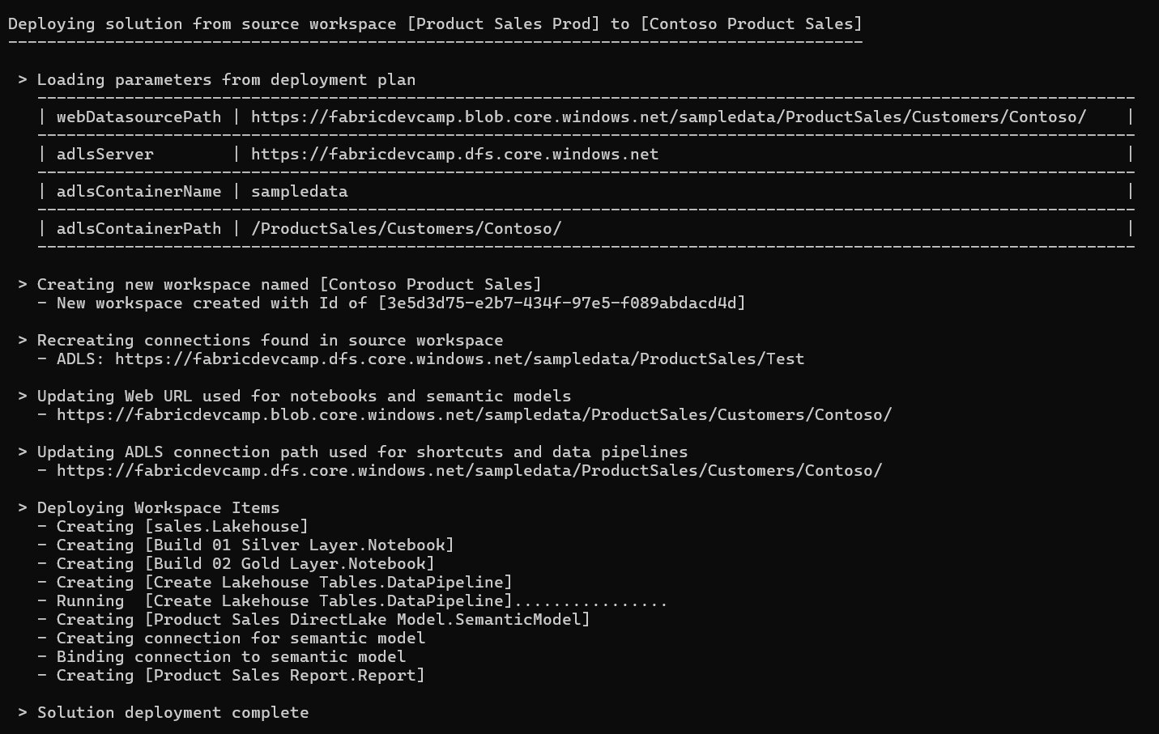

Slide 62
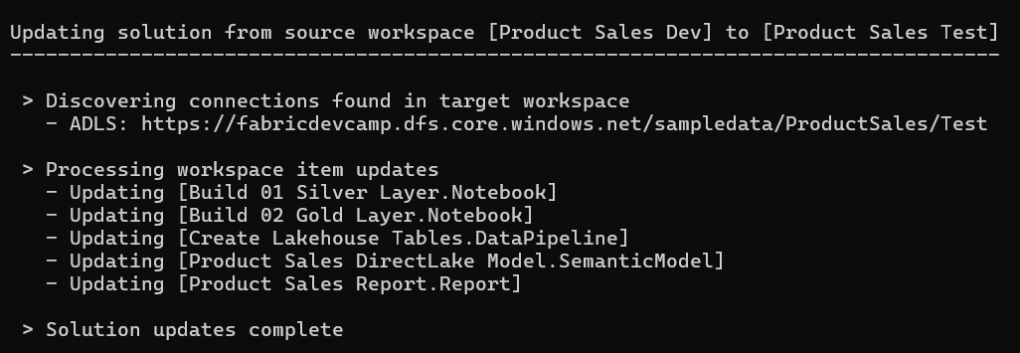


Slide 63
Agenda
Introduction to Fabric Solution Deployment
Challenges in Fabric Solution Deployment
Implementing Workflows to Deloy Fabric Solutions
Integrating Creation Parameters for Customer Data
Deploying and Updating Solutions from a Source Workspace
Implementing CI/CD using Staged Deployments
Managing Item Definitions using Fabric GIT Integration

Slide 64

Connecting Fabric Workspace to GIT Repositories
Fabric workspace can be connected to GIT repository
Fabric currently supports GIT repositories in Azure Dev Ops and GitHub
Workspace connections can be configured by hand or through Fabric REST APIs
Once connected, workspace items serialized as item definition files in GIT repository
GIT connection to workspace provides 2-way synchronization
Changes made to workspace items can be synchronized to GIT repository files
Changes committed to GIT repository files can be synchronized to workspace items
GIT
Sync

Slide 65


Workspace settings for Git Integration
Workspace can be connected to Azure Dev Ops repository from Workspace Settings
First, you need to create an Azure Dev Ops project and initialize its main repository
Create workspace connection to ADO repository using Git Integration tab in Workspace Settings dialog
Once connected, workspace items list shows Git status

Slide 66
Fabric GIT APIs
Fabric GIT APIs allow developer to automate creating workspace connections
Connect | Connect a specific workspace to a git repository and branch.
Disconnect | Disconnect a specific workspace from the Git repository and branch it is connected to.
Initialize Connection | Initialize a connection for a workspace that is connected to Git.
Get Connection | Returns git connection details for the specified workspace.
Commit To Git | Commits the changes made in the workspace to the connected remote branch.
Get Status | Returns the Git status of items in the workspace, that can be committed to Git.
Update From Git | Updates the workspace with commits pushed to the connected branch. ConflictResolutionPolicy helps to determine which way to sync: GIT->Workspace or Workspace->GIT
66
Microsoft Fabric
Notes:
Talk about selective commit , changes as part of roadmap
Mention irreversible nature of workspace update from GIT

Slide 67


Slide 68
Item Definitions maintained inside Git-enabled Repository

Slide 69
Summary
Introduction to Fabric Solution Deployment
Challenges in Fabric Solution Deployment
Implementing Workflows to Deloy Fabric Solutions
Integrating Creation Parameters for Customer Data
Deploying and Updating Solutions from a Source Workspace
Implementing CI/CD using Staged Deployments
Managing Item Definitions using Fabric GIT Integration

Slide 70

Options for Creating Solution Template for Deployment
Option 1: Use a live workspace as the source solution template
Option 2: Use Fabric item definition files packaged in a solution folder
Fabric Solution Template
Solution Deployment Logic
Target
Workspace
Fabric Solution Template
Solution Deployment Logic
Target
Workspace

